Slide 1


The LJMU Experience
Topic : Semantic Processing

Slide 2
Agenda
1.
Introduction to Word2Vec models and Setup with Gensim
2.
Training Word2Vec Models and Analogies
3.
Applying Vector Operations and Understanding Word Relationships
4.
QnR
Notes:
Note to SMEs: Start the session with a recall of the concepts taught in core content would help build a connection between the two
For example, if teaching a session on e-skills, asking the learners what they understood from the first module or the core concepts that were taught in module

Slide 3
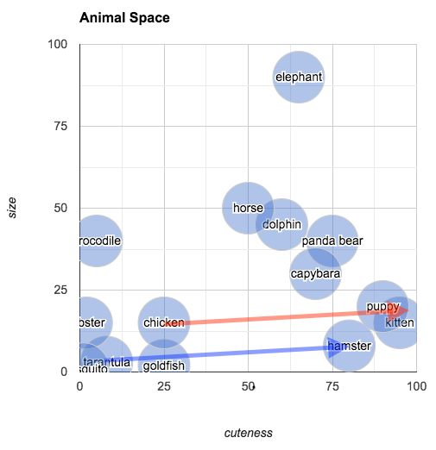
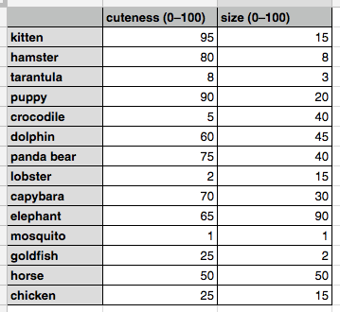
What is Embedding?
Vector- A quantity having direction as well as magnitude, especially as determining the position of one point in space relative to another.

Slide 4
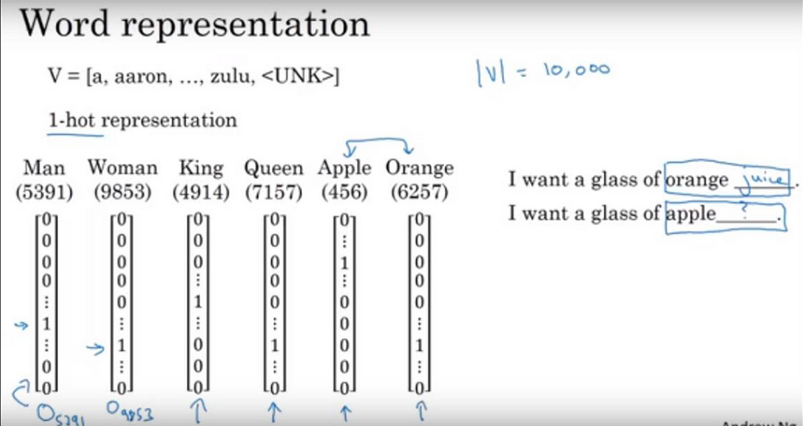
One-hot vector
Each word is represented by a 1-hot vector of size 10,000:
All elements are zero except one position that corresponds to the word’s index.
E.g., for the word “Orange” (index 6257), the one-hot vector has 1 at position 6257, rest are 0.
These vectors are sparse, high-dimensional, and do not capture meaning or relationships between words.

Slide 5
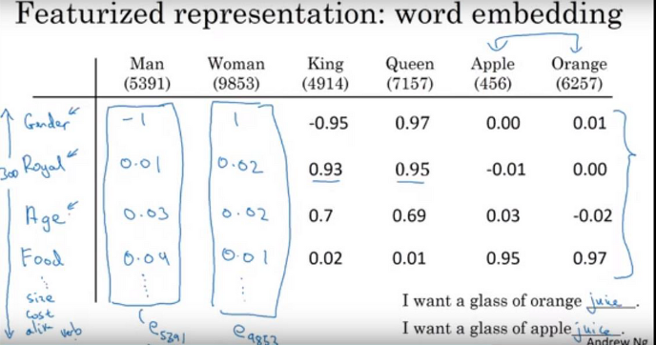
Featurized representation: word embedding
Instead of sparse one-hot vectors, we now represent each word with a dense vector of real numbers (size 300), capturing semantic features like gender, royalty, age, or food.
Now the model knows: ✔ Both "apple" and "orange" have high food feature values, so they're similar. ✔ "Man" and "Woman" differ in gender, not in food.

Slide 6

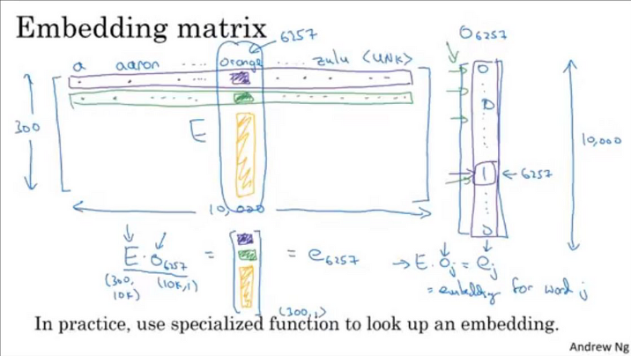
Embedding Matrix Mechanism
We store all 10,000 word vectors (each of size 300) in an embedding matrix E of shape (10,000 × 300). Each row corresponds to a word.
For word "orange", index = 6257
One-hot vector o₆₂₅₇ = [0, ..., 1 at 6257, ..., 0]
E.Oj=ej (E=embedded matrix, O=1-hot representation)

Slide 7
TF-IDF vs Word Embedding
🔍 Aspect | 🧮 TF-IDF (Bag-of-Words) | 🧠 Word Embeddings (Dense Vectors)
Meaning/Semantics | No meaning captured. “car” ≠ “vehicle” | Captures meaning. “car” ≈ “vehicle”
Word Order | Ignored. “Dog bites man” = “Man bites dog” | Handled (in contextual embeddings). Understands the sentence meaning.
Context | Not captured. “apple” in tech vs. fruit is treated the same | Captures context. “apple” (fruit) ≠ “Apple” (company)
Vector Type | Sparse, high-dimensional (e.g., 10,000+ features) | Dense, low-dimensional (e.g., 300 features)
Generalization | Cannot handle unseen words (OOV = Out-of-Vocabulary) | Can estimate unseen words (esp. with subword models like fastText)
Pretraining | Not applicable — must train from scratch on your dataset | Pretrained on large corpora (e.g., GloVe, Word2Vec, BERT) — ready to use
Relationship Handling | No understanding of synonyms or analogies | Understands: “king” - “man” + “woman” ≈ “queen”
Topic Clustering | No clustering — words are isolated | “apple”, “pear”, “banana” cluster in the “fruit” region
Size & Efficiency | Inefficient — long and mostly zeros | Efficient — short, information-rich vectors
Use Case Fit | Good for simple, interpretable models | Better for deep learning and semantic tasks

Slide 8
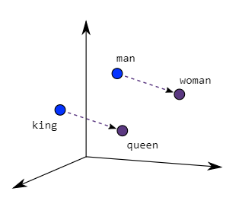
Word2Vec
Word2Vec creates vectors of the words that are distributed numerical representations of word features – these word features could comprise of words that represent the context of the individual words present in our vocabulary. Word embeddings eventually help in establishing the association of a word with another similar meaning word through the created vectors.
As seen in the image below where word embeddings are plotted, similar meaning words are closer in space, indicating their semantic similarity.
Two different model architectures that can be used by Word2Vec to create the word embeddings are the Continuous Bag of Words (CBOW) model & the Skip-Gram model.

Slide 9
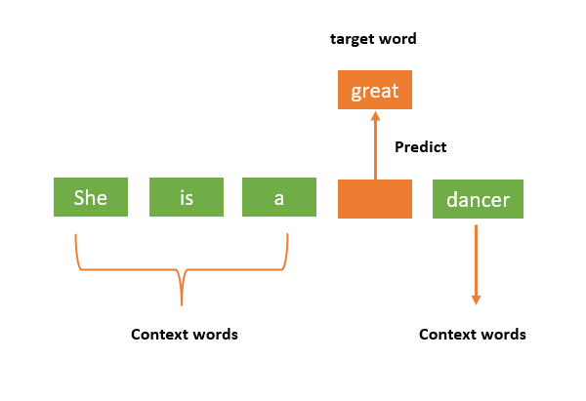
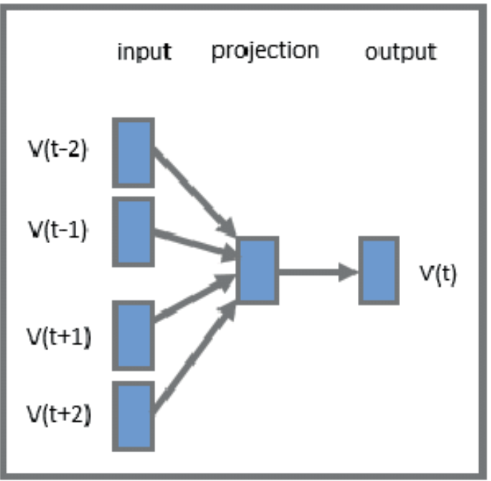
Continuous Bag Of Words
CBOW is a type of word2vec model introduced by Mikolov et al. (2013).
The idea is to predict a target word based on the surrounding context words.
Given a window of context words around a missing word, CBOW tries to predict the missing word.
For example, if we consider the sentence – “Word2Vec has a deep learning model working in the backend.”, there can be pairs of context words and target (center) words. If we consider a context window size of 1, we will have pairs like ([deep, model], learning), ([model, in], working), ([a, learning), deep) etc.

Slide 10
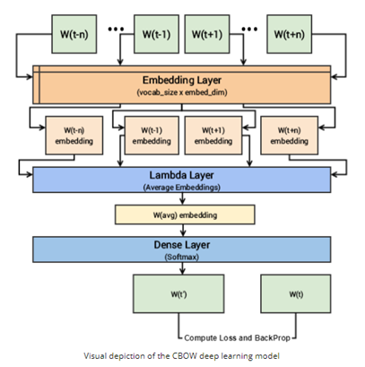
CBOW
The context words are first passed as an input to an embedding layer (initialized with some random weights) as shown in the Figure below.
The word embeddings are then passed to a lambda layer where we average out the word embeddings.
We then pass these embeddings to a dense SoftMax layer that predicts our target word. We match this with our target word and compute the loss and then we perform backpropagation with each epoch to update the embedding layer in the process.
We can extract out the embeddings of the needed words from our embedding layer, once the training is completed.

Slide 11
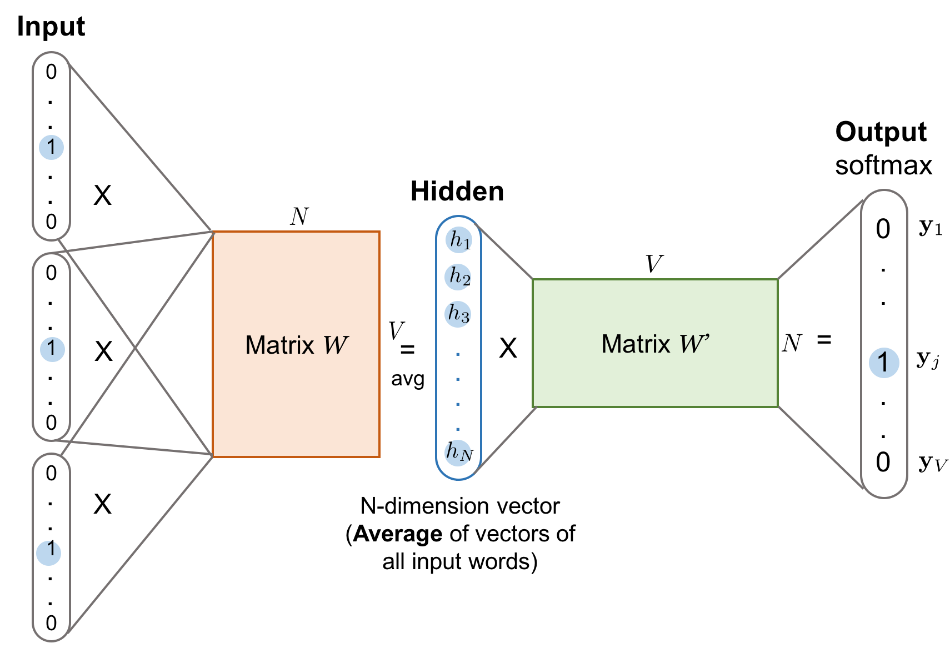
CBOW
The optimal window size depends on the nature of your data and the task at hand:
Smaller Window (e.g., 1–3): Better for capturing syntactic relationships, such as grammar and word order.
Larger Window (e.g., 5–10): More effective for capturing semantic relationships, such as word meanings and associations.

Slide 12
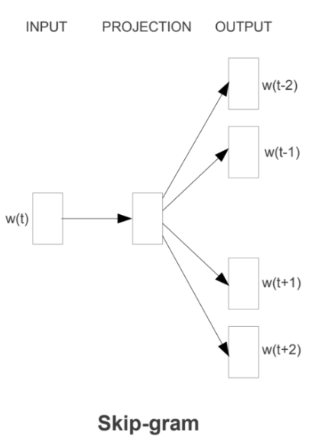
Skip Gram
The Skip-Gram model works by using a target word to predict its surrounding context words within a specified window size. The window size defines how many words before and after the target word are considered as context
For example, in the sentence:
"The quick brown fox jumps over the lazy dog"
Target Word: "jumps"
Window Size: 2
The context words would be
Before: "quick", "brown"
After: "over", "the"

Slide 13
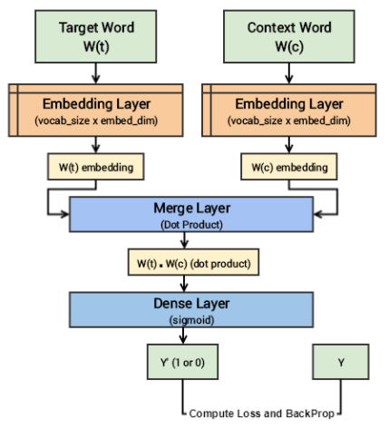
Skip-Gram
So, considering the same sentence – “Word2Vec has a deep learning model working in the backend.” and a context window size of 1, given the centre word ‘learning’, the model tries to predict [‘deep’, ’model’] and so on.
These samples make the model aware of the contextually relevant words and consequently generate similar embeddings for similar meaning words.
Since the skip-gram model has to predict multiple words from a single given word, we feed the model pairs of (X, Y) where X is our input and Y is our label. This is done by creating positive input samples and negative input samples
Positive Input Samples will have the training data in this form: [(target, context),1] where the target is the target or centre word, context represents the surrounding context words, and label 1 indicates if it is a relevant pair.
Negative Input Samples will have the training data in the same form: [(target, random),0]. In this case, instead of the actual surrounding words, randomly selected words are fed in along with the target words with a label of 0 indicating that it’s an irrelevant pair.

Slide 14
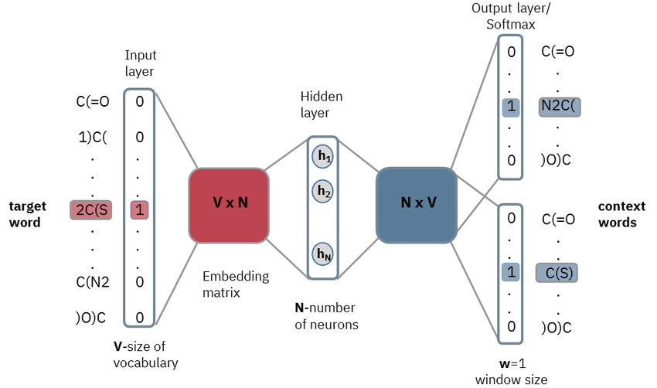
Skip Gram
Both the target and context word pairs are passed to individual embedding layers from which we get dense word embeddings for each of these two words.
We then use a ‘merge layer’ to compute the dot product of these two embeddings and get the dot product value.
This dot product value is then sent to a dense sigmoid layer that outputs either 0 or 1.
The output is compared with the actual label and the loss is computed followed by backpropagation with each epoch to update the embedding layer in the process.
The major drawbacks of such Neural Network based Language Models are:
High Training & Testing time
Inability to capture the statistical information at a global level (they are not considering the count or co-occurrence of words in a global context).

Slide 15
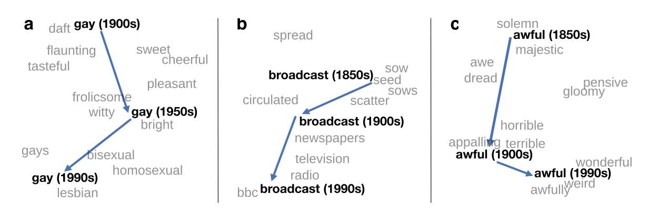
Glove
GloVe is based on ratios of probabilities from the word-word co-occurrence matrix, combining the intuitions of count-based models while also capturing the linear structures used by methods like word2vec.
“GloVe is a count-based, unsupervised learning model that uses co-occurrence (how frequently two words appear together) statistics at a Global level to model the vector representations of words.”
Since the statistics are captured at a global level directly by the model, it is named as ‘Global Vectors’ model.
GloVe is introduced by Jeffrey Pennington, Richard Socher, Christopher D. Manning of Stanford University in the year 2014 and has ever since gained popularity among NLP practitioners due to its simplicity and performance.

Slide 16
Glove
The basic idea behind the GloVe word embedding is to derive the relationship between the words from statistics. Unlike the occurrence matrix, the co-occurrence matrix tells you how often a particular word pair occurs together. Each value in the co-occurrence matrix represents a pair of words occurring together.
Given two corpus:
The fast cat wears no hat
The cat in the hat ran fast
Step 1: Extract unique words (vocabulary)
Let's lowercase all words and list unique tokens:
Vocabulary size = 8.
Index | Word
0 | the
1 | fast
2 | cat
3 | wears
4 | no
5 | hat
6 | in
7 | ran
Step 2: Define context window
Use a window size = 1 (just the immediate neighbors) for simplicity.
Step 3: Build co-occurrence matrix XXX
Rows and columns = vocabulary words in order.
Xij = how many times word j appeared next to word i within the context window.

Slide 17
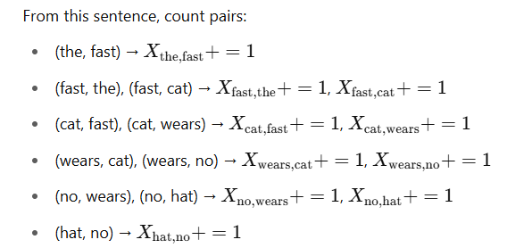
Glove
Step 4: Count co-occurrences in each sentence
Sentence 1: "the fast cat wears no hat"
Position | Word | Context words (window=1)
0 | the | fast
1 | fast | the, cat
2 | cat | fast, wears
3 | wears | cat, no
4 | no | wears, hat
5 | hat | no
Sentence 2: "the cat in the hat ran fast"
Position | Word | Context words (window=1)
0 | the | cat
1 | cat | the, in
2 | in | cat, the
3 | the | in, hat
4 | hat | the, ran
5 | ran | hat, fast
6 | fast | ran

Slide 18
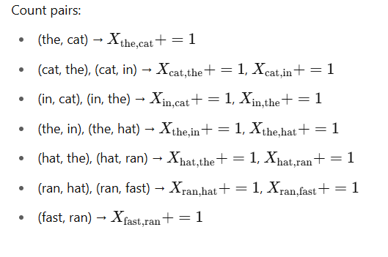
Glove
 | the | fast | cat | wears | no | hat | in | ran
the | 0 | 1 | 1 | 0 | 0 | 1 | 1 | 0
fast | 1 | 0 | 1 | 0 | 0 | 0 | 0 | 1
cat | 1 | 1 | 0 | 1 | 0 | 0 | 1 | 0
wears | 0 | 0 | 1 | 0 | 1 | 0 | 0 | 0
no | 0 | 0 | 0 | 1 | 0 | 1 | 0 | 0
hat | 1 | 0 | 0 | 0 | 1 | 0 | 0 | 1
in | 1 | 0 | 1 | 0 | 0 | 0 | 0 | 0
ran | 0 | 1 | 0 | 0 | 0 | 1 | 0 | 0
The matrix is not symmetric because co-occurrence depends on the order in the sentence (word vs context word).
You could make it symmetric by summing Xij+ji​, but GloVe handles the asymmetry.

Slide 19
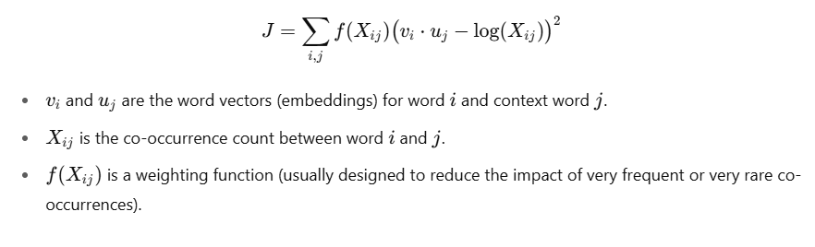
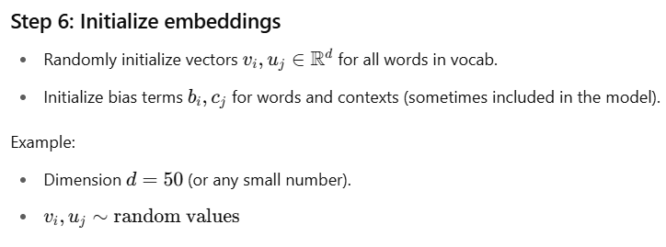
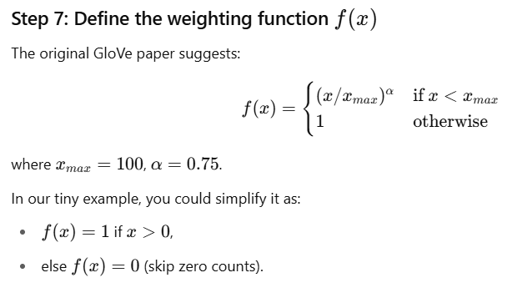
Glove

Slide 20
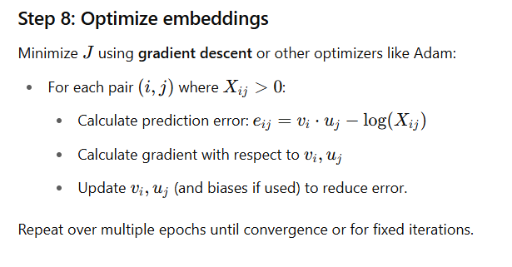
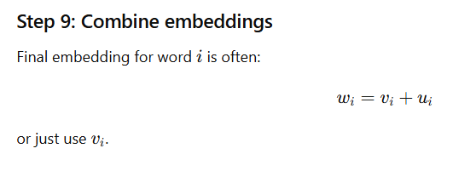
Glove

Slide 21
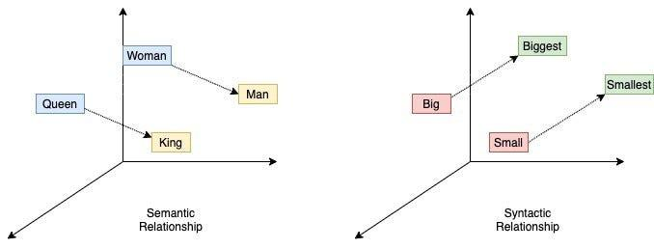
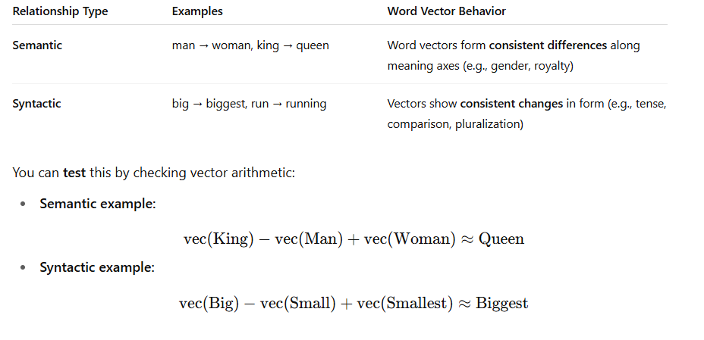
Analogies
Queen-Woman = King-Man
Rewriting,
Queen-Woman+Man = King

Slide 22
SynSets
Synsets (short for "synonym sets") are a fundamental concept in WordNet, a large lexical database of English developed at Princeton.
For the concept of car, WordNet provides this synset:
car.n.01
→ Synonyms: car, auto, automobile, machine, motorcar
→ Definition: a motor vehicle with four wheels; usually propelled by an internal combustion engine
→ Example: "He needs a car to get to work."
A synset is a group of words (or phrases) that are synonyms, meaning they express the same concept or meaning.
Each synset is also associated with:
A definition (gloss)
One or more example sentences
Semantic relationships (like hypernyms, hyponyms, antonyms)
WordNet organizes words into four major parts of speech:
n = noun
v = verb
a = adjective
r = adverb
Each synset is assigned a unique ID, like bank.n.01, run.v.05, etc.

Slide 23

Thank You!!

